Slide 1
Nominal Optimization
For various fixed bank angles, global optimization is performed to minimize SRP fuel consumption
Optimization Variables:
Entry FPA
Bank Reversal Velocity
Target Downrange
Along a given entry trajectory, the lowest SRP fuel cost to land at the target is reported
Optimal trajectories always ignite at the minimum altitude constraint
The “high elevation” parametrization yields superior performance, but perhaps not as large an improvement as expected (~10%)

Slide 2
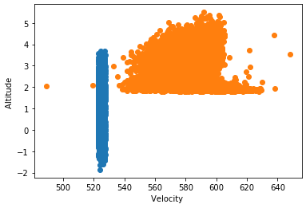
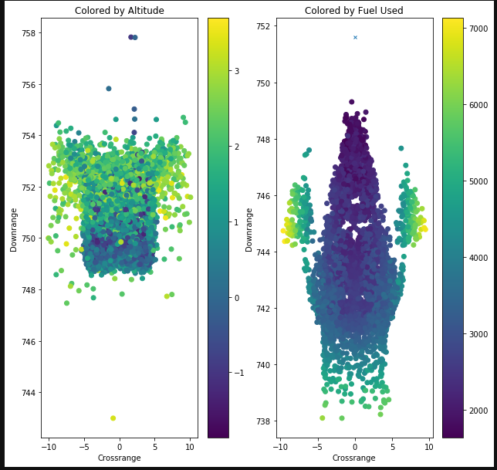
Apollo + Adaptive Trigger
Adaptive Trigger based on tabulated optimal solutions
Traditional Apollo trigger at fixed velocity from reference trajectory

Slide 3
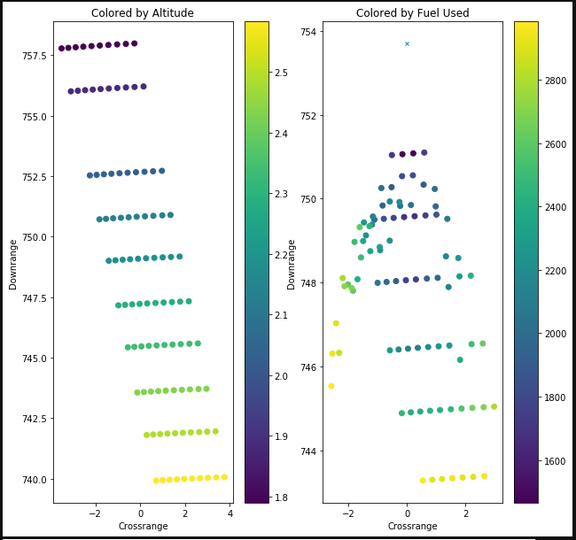
Changing 2nd reversal
Changing 1st reversal

Slide 4
For the same altitude, velocity, and flight path angle, any point on the red circle will produce an equivalent SRP trajectory so long as the heading points to the target
Targeted Landing Site
Optimal SRP Ignition (Nominal Scenario)
This is interesting because it means that unlike with parachute architectures which attempt to arrive at zero crossrange, there is no such restriction on the ignition conditions. Instead, matching heading is the important feature.
Entry trajectory, steered by bank angle commands, executed by small
RCS thrusters
Downrange
Atmospheric entry interface
Crossrange

Slide 5
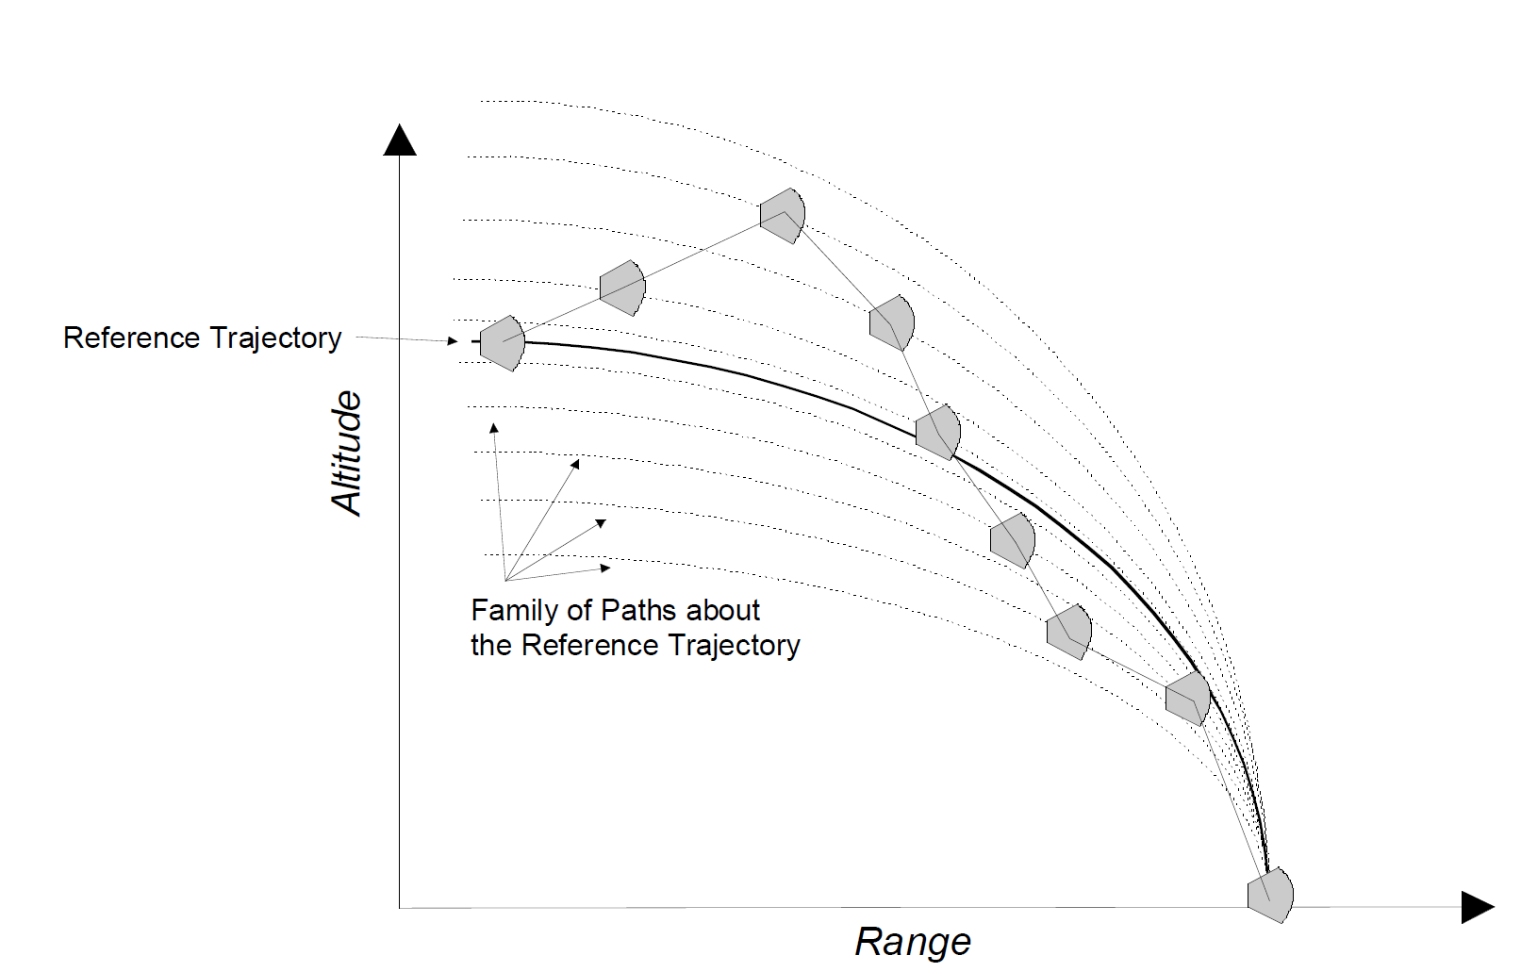
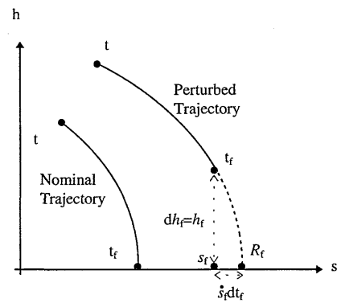

Slide 6
Optimal Ignition Surface at a fixed velocity

